Slide 1
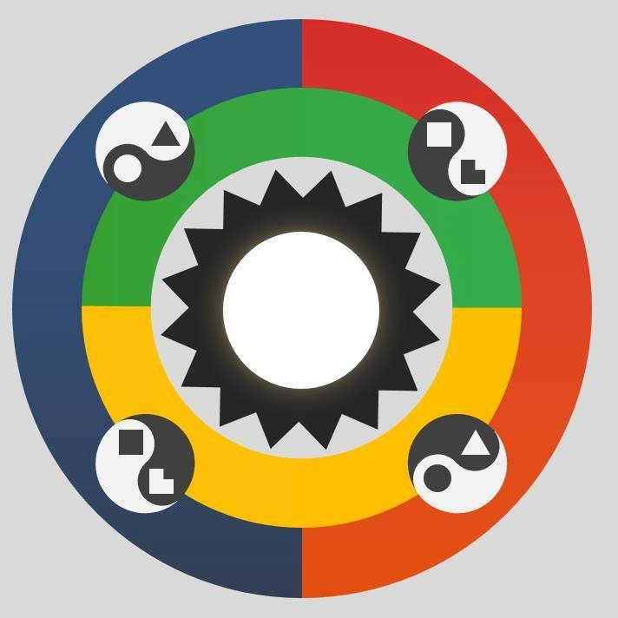
SOCIONICS
All slides are copyrighted by Jack Oliver Aaron of the World Socionics Society
A CRASH COURSE

Slide 2
3. FUNCTIONS
Part 2
All slides are copyrighted by Jack Oliver Aaron of the World Socionics Society

Slide 3
SO FAR
All slides are copyrighted by Jack Oliver Aaron of the World Socionics Society
Information Elements
Information Metabolism

Slide 4
TODAY
All slides are copyrighted by Jack Oliver Aaron of the World Socionics Society
Information Elements
Information Metabolism
Functions

Slide 5
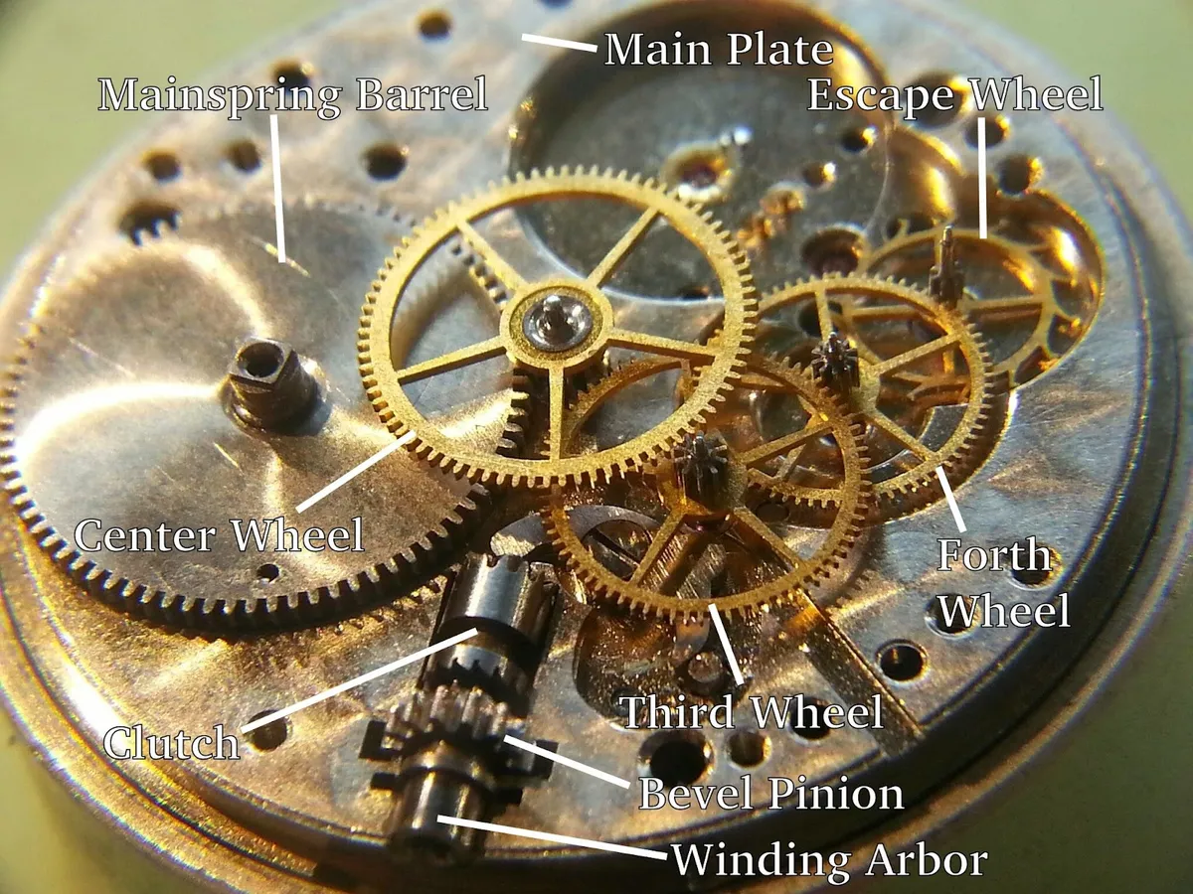
WHAT IS A FUNCTION?
All slides are copyrighted by Jack Oliver Aaron of the World Socionics Society
A lens
A fluid intelligence
A process, program or approach
An agent or driving spirit
A PART OF YOU

Slide 6

FUNCTION AS A LENS
All slides are copyrighted by Jack Oliver Aaron of the World Socionics Society
Key to shaping perspectives
People can see things differently
What is important to you?
What is not important to others?

Slide 7
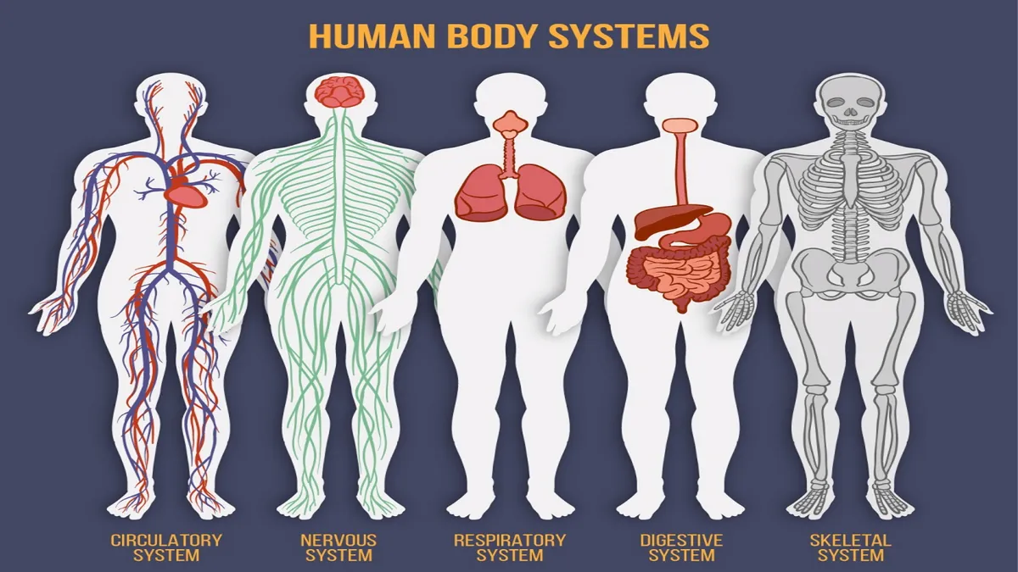
FUNCTION AS A PROGRAM
All slides are copyrighted by Jack Oliver Aaron of the World Socionics Society
The mind is complex
Complexity involves multiple programs
Work partly alone, and partly together
Supports the person overall

Slide 8
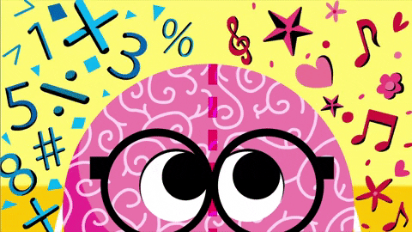
FUNCTION AS A FLUID INTELLIGENCE
All slides are copyrighted by Jack Oliver Aaron of the World Socionics Society
Functions learn
Crystal intelligence is what you know
Fluid intelligence is how you learn
How much can you learn?
How quickly you can learn,
How well you can apply what you have learnt?
But NOT IQ!

Slide 9
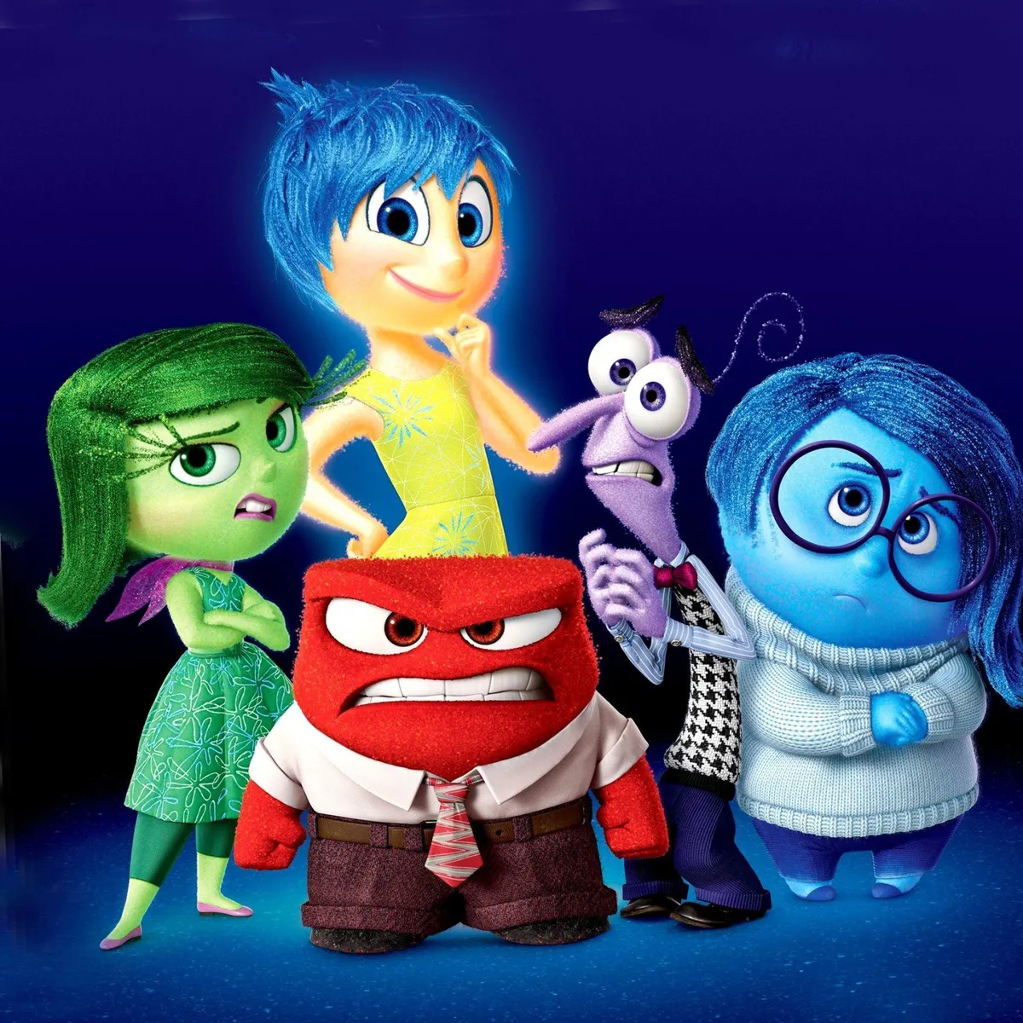
FUNCTION AS AN AGENT
All slides are copyrighted by Jack Oliver Aaron of the World Socionics Society
Like little people within you
Each has a distinct style or mini-personality
People’s manner and attitude changes
Different person for a different situation

Slide 10
IM ELEMENTS VS. FUNCTIONS
All slides are copyrighted by Jack Oliver Aaron of the World Socionics Society
IM Elements | Functions
The WHAT Passive Are processed and acted upon Everything you interact with The varieties of fuel | The HOW Active Operate within the psyche The rules for how you interact The motors and engines

Slide 11
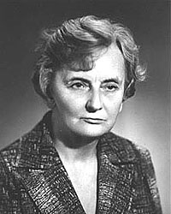
MODEL A
All slides are copyrighted by Jack Oliver Aaron of the World Socionics Society
Example of SEE
A for Augusta
‘filing cabinet’ of the psyche
Each box is a Function
Each Function is numbered, 1-8
Each IM Element is assigned to a Function
For each type, IM Elements are assigned differently
1
2
4
3
6
5
7
8

Slide 12
FUNCTION DICHOTOMIES
All slides are copyrighted by Jack Oliver Aaron of the World Socionics Society
Public vs. Private
Strong vs. Weak
Valued vs. Neglected

Slide 13

PUBLIC VS. PRIVATE
All slides are copyrighted by Jack Oliver Aaron of the World Socionics Society
Public | Private
Interacts with outside world Opportunities and risks Where we feel judged by others | Consults inner self Needs and areas to play with Pain, pride, or refuge from stress
1 | 2
4 | 3
6 | 5
7 | 8

Slide 14
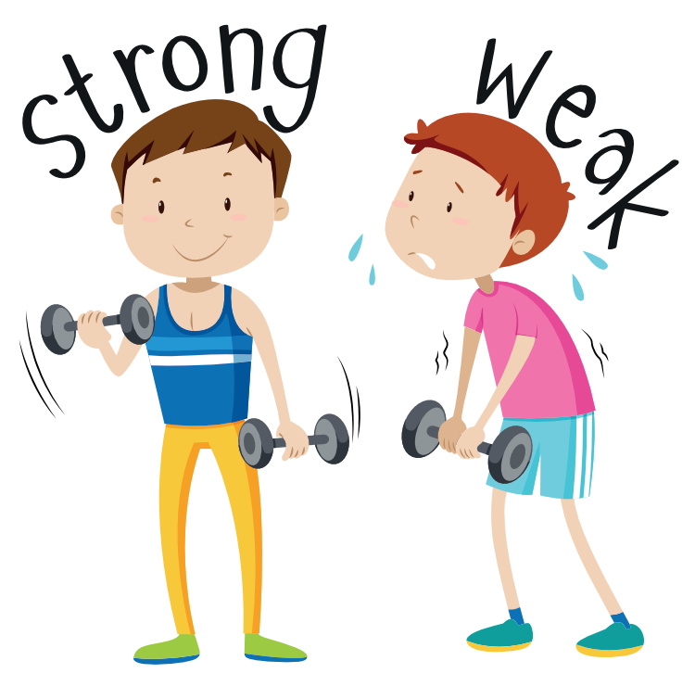
STRONG VS. WEAK
All slides are copyrighted by Jack Oliver Aaron of the World Socionics Society
Strong | Weak
Reliable and successful Confident and insightful Applies well to new situations Quickly knows what to do Highly efficient | Unreliable, prone to failure Doubtful and rudimentary Caught out in new situations Gets better with practice Inefficient
1 | 2
4 | 3
6 | 5
7 | 8

Slide 15

VALUED VS. NEGLECTED
All slides are copyrighted by Jack Oliver Aaron of the World Socionics Society
Valued | Neglected
Appreciated for its own sake Meaningful to achieve Sought out in others | Treated as a tool A burden or chore Misunderstood in others
1 | 2
4 | 3
6 | 5
7 | 8

Slide 16
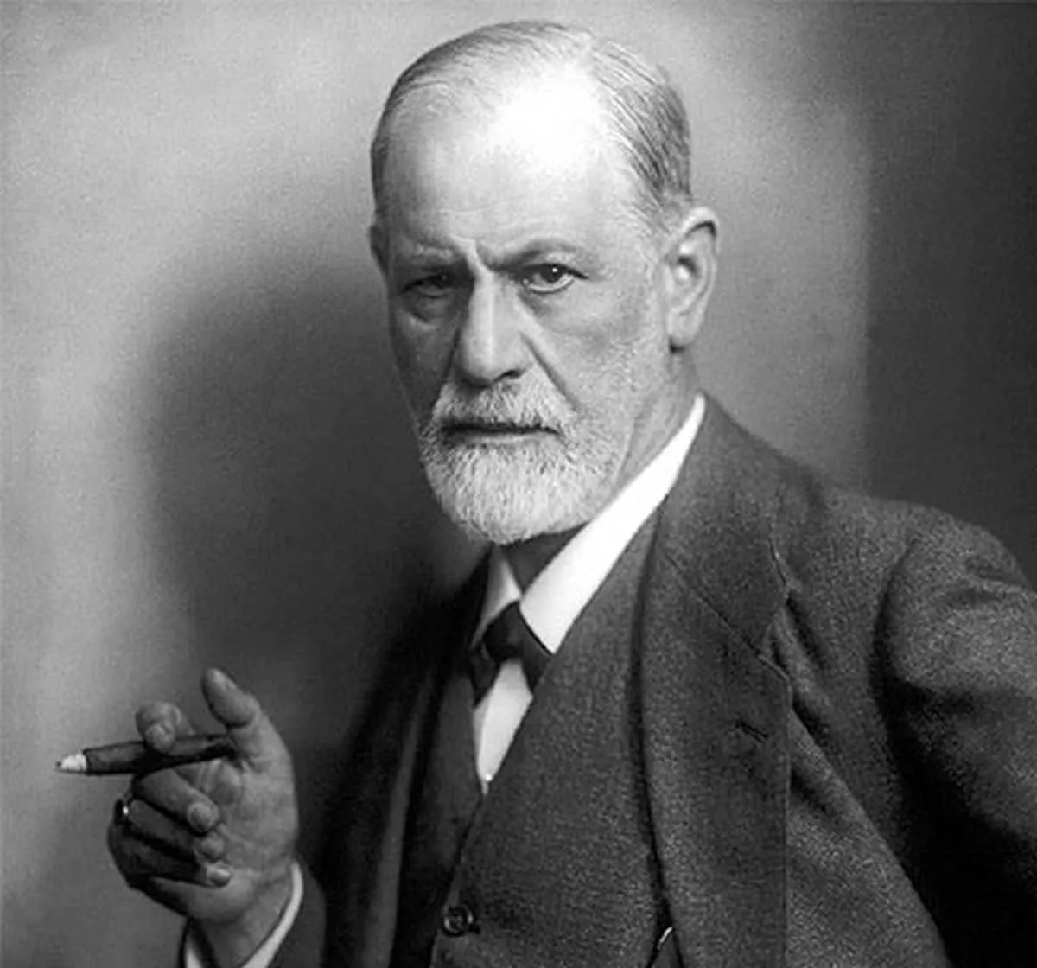
4 Blocks of the Psyche
All slides are copyrighted by Jack Oliver Aaron of the World Socionics Society
 | Strong | Weak
Valued | Ego | Super-Id
Neglected | Id | Super-Ego
 | Strong | Weak
Public | Ego | Super-Ego
Private | Id | Super-Id

Slide 17
EGO: LEADING + CREATIVE
All slides are copyrighted by Jack Oliver Aaron of the World Socionics Society
Public, Strong and Valued
Who I am and what I bring
Full of confidence and positivity
Our best foot forward
Motivational driving-seat
Can be overdone
1 | 2
4 | 3
6 | 5
7 | 8

Slide 18
SUPER-EGO: ROLE + VULNERABLE
All slides are copyrighted by Jack Oliver Aaron of the World Socionics Society
Public, Weak and Neglected
What is demanded of me
Burdensome and difficult
What I would rather do without
The turn-off
Likely to fail
1 | 2
4 | 3
6 | 5
7 | 8

Slide 19
SUPER-ID: SUGGESTIVE + MOBILISING
All slides are copyrighted by Jack Oliver Aaron of the World Socionics Society
Private, Weak and Valued
Personal needs and aspirations
Admired in others
Rewarding to do
Grows over time
Painful if there is failure
1 | 2
4 | 3
6 | 5
7 | 8

Slide 20
ID: IGNORING + DEMONSTRATIVE
All slides are copyrighted by Jack Oliver Aaron of the World Socionics Society
Private, Strong and Neglected
What I take for granted
Confident but avoids attention
The boring parts of the self
Back-up resources
Not expected of others
1 | 2
4 | 3
6 | 5
7 | 8

Slide 21
EXERCISES - PART 1
All slides are copyrighted by Jack Oliver Aaron of the World Socionics Society
Ask yourself these questions:
What am I fundamentally about as a person?
What do I admire and appreciate in others?
What can I do that isn’t important to me?
What sort of people do I see as particularly strange?

Slide 22
INFORMATION DICHOTOMIES
All slides are copyrighted by Jack Oliver Aaron of the World Socionics Society
Public vs. Private
Strong vs. Weak
Valued vs. Neglected
Obvious vs. Subtle
Constant vs. Variable

Slide 23
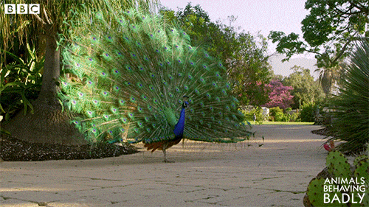
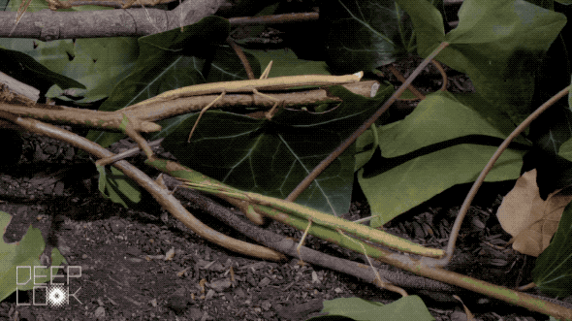
OBVIOUS VS. SUBTLE
All slides are copyrighted by Jack Oliver Aaron of the World Socionics Society
Obvious | Subtle
High energy Clear and easy to see Explicit from people’s actions Noticed quickly | Low energy Harder to see Implicit to people’s intentions Read between the lines
1 | 2
4 | 3
6 | 5
7 | 8

Slide 24


CONSTANT VS. VARIABLE
All slides are copyrighted by Jack Oliver Aaron of the World Socionics Society
Constant | Variable
Maintains consistent energy Always on or always off More stable for typing | Activates in certain situations Goes from on to off and back Need context for typing
1 | 2
4 | 3
6 | 5
7 | 8

Slide 25
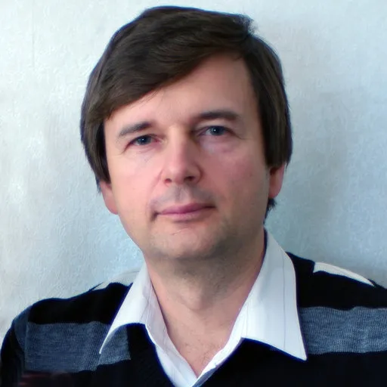
4 Function Dimensions
All slides are copyrighted by Jack Oliver Aaron of the World Socionics Society
 | Strong | Weak
Obvious | 4D | 2D
Subtle | 3D | 1D
 | Strong | Weak
Constant | 4D | 1D
Variable | 3D | 2D

Slide 26
4-DIMENSIONAL: LEADING & DEMONSTRATIVE
All slides are copyrighted by Jack Oliver Aaron of the World Socionics Society
1 | 2
4 | 3
6 | 5
7 | 8
Strong, Constant and Obvious
Shows up BIG & LOUD
What we do the most
Impactful and successful
Confidence is unshakeable

Slide 27
3-DIMENSIONAL: CREATIVE & IGNORING
All slides are copyrighted by Jack Oliver Aaron of the World Socionics Society
1 | 2
4 | 3
6 | 5
7 | 8
Strong, Variable and Subtle
Quiet but highly capable
Flavours and guides 4D
Influences from the shadows
Knows its worth without boasting

Slide 28
2-DIMENSIONAL: ROLE & MOBILISING
All slides are copyrighted by Jack Oliver Aaron of the World Socionics Society
1 | 2
4 | 3
6 | 5
7 | 8
Weak, Variable and Obvious
Makes an awkward splash
Surfaces under certain conditions
Overconfident, may succeed or flop
Gets better with practice

Slide 29
1-DIMENSIONAL: VULNERABLE & SUGGESTIVE
All slides are copyrighted by Jack Oliver Aaron of the World Socionics Society
1 | 2
4 | 3
6 | 5
7 | 8
Weak, Constant and Subtle
Measured by their absence
Most out of character
Frequently fails and expects to fail
Lacks confidence and needs help

Slide 30
EXERCISES - PART 2
All slides are copyrighted by Jack Oliver Aaron of the World Socionics Society
Ask yourself these questions:
In what situations am I at my most confident?
In what situations am I at my least confident?
What strengths do people not immediately notice about me?
In what ways do I look more confident than I actually am?

Slide 31
INFORMATION DICHOTOMIES
All slides are copyrighted by Jack Oliver Aaron of the World Socionics Society
Public vs. Private
Strong vs. Weak
Valued vs. Neglected
Obvious vs. Subtle
Constant vs. Variable
Stubborn vs. Flexible
Demanding vs. Supplying

Slide 32
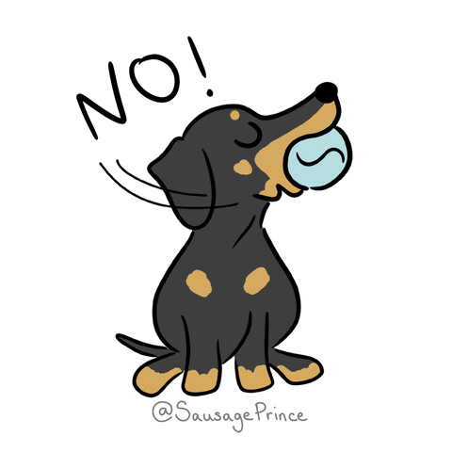
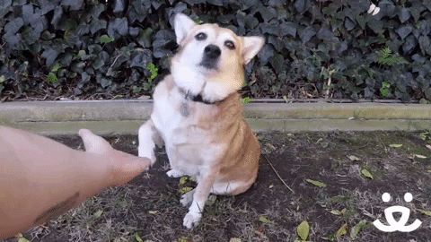
STUBBORN VS. FLEXIBLE
All slides are copyrighted by Jack Oliver Aaron of the World Socionics Society
Stubborn | Flexible
Sets own focus Refuses to be influenced Overrides other functions | Adapts to environment Open to suggestions Works with other functions
1 | 2
4 | 3
6 | 5
7 | 8

Slide 33

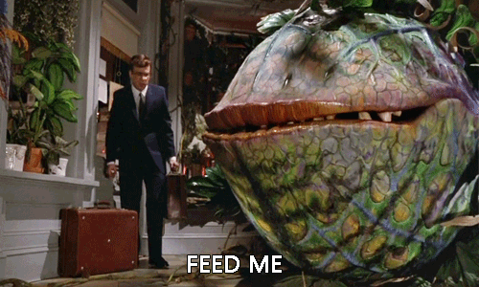
DEMANDING VS. SUPPLYING
All slides are copyrighted by Jack Oliver Aaron of the World Socionics Society
Demanding | Supplying
Sets the goal for the block Leads What to do | Fulfils the goal for the block Supports How to do it
1 | 2
4 | 3
6 | 5
7 | 8

Slide 34
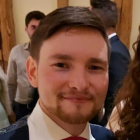
4 Function Approaches
All slides are copyrighted by Jack Oliver Aaron of the World Socionics Society
 | Valued | Neglected
Stubborn | Assertive | Intransigent
Flexible | Collaborative | Reluctant
 | Obvious | Subtle
Stubborn | Assertive | Intransigent
Flexible | Reluctant | Collaborative

Slide 35
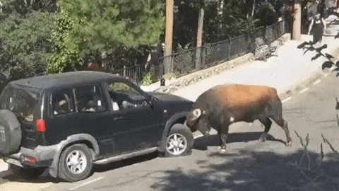
ASSERTIVE: LEADING & MOBILISING
All slides are copyrighted by Jack Oliver Aaron of the World Socionics Society
1 | 2
4 | 3
6 | 5
7 | 8
Valued, Stubborn and Obvious
The impact we want to have
Where we want to lead
Does not take ‘no’ for an answer
Competes with others

Slide 36
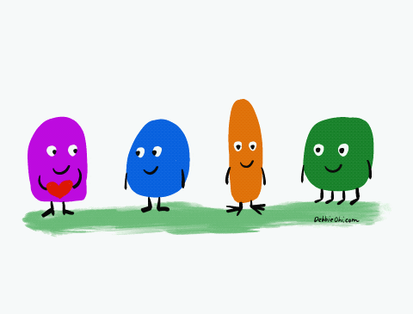
COLLABORATIVE: CREATIVE & SUGGESTIVE
All slides are copyrighted by Jack Oliver Aaron of the World Socionics Society
1 | 2
4 | 3
6 | 5
7 | 8
Valued, Flexible and Subtle
What put together with others
Where we want to team up
Flexes itself around other people
Yields to worthy input

Slide 37
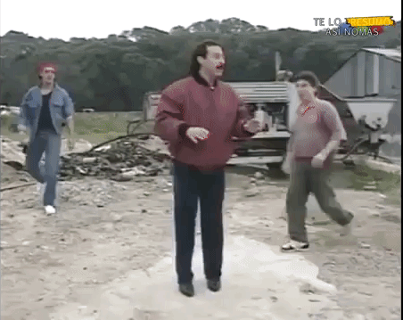
RELUCTANT: ROLE & DEMONSTRATIVE
All slides are copyrighted by Jack Oliver Aaron of the World Socionics Society
1 | 2
4 | 3
6 | 5
7 | 8
Neglected, Flexible and Obvious
What we would rather not do
Where we make compromises
Does what is needed to get by
Responds without escalating

Slide 38
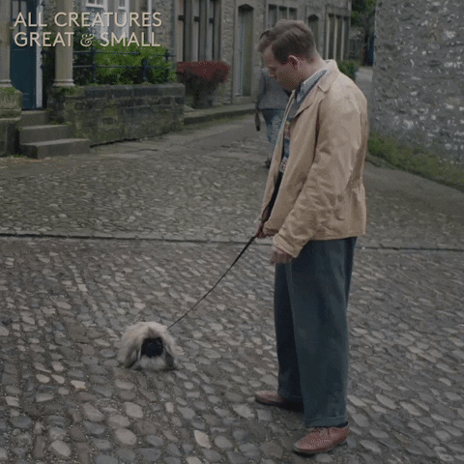
INTRANSIGENT: VULNERABLE & IGNORING
All slides are copyrighted by Jack Oliver Aaron of the World Socionics Society
1 | 2
4 | 3
6 | 5
7 | 8
Neglected, Stubborn and Subtle
What we will refuse to do
Where we don’t bend
Antithetical to ourselves
Declines participation

Slide 39
EXERCISES - PART 3
All slides are copyrighted by Jack Oliver Aaron of the World Socionics Society
Ask yourself these questions:
What do I tend to push onto others?
What am I most open to from others?
How do I have to adapt myself to others?
What sorts of behaviours would contradict who I am?

Slide 40
What we learned…
All slides are copyrighted by Jack Oliver Aaron of the World Socionics Society
Dichotomies | Qualities
Public + Strong + Valued | Ego
Public + Weak + Neglected | Super-Ego
Private + Weak + Valued | Super-Id
Private + Strong + Neglected | Id
Strong + Constant + Obvious | 4D
Strong + Variable + Subtle | 3D
Weak + Variable + Obvious | 2D
Weak + Constant + Subtle | 1D
Valued + Stubborn + Obvious | Assertive
Valued + Flexible + Subtle | Collaborative
Neglected + Flexible + Obvious | Reluctant
Neglected + Stubborn + Subtle | Intransigent
 | Function
1 | Public | Private
2 | Strong | Weak
3 | Valued | Neglected
4 | Obvious | Subtle
5 | Constant | Variable
6 | Stubborn | Flexible
7 | Demanding | Supplying

Slide 41
NEXT TIME
All slides are copyrighted by Jack Oliver Aaron of the World Socionics Society
Block | Dimension | Approach | Function
Ego | 4D | Assertive | 1
Ego | 3D | Collaborative | 2
Super-Ego | 2D | Reluctant | 3
Super-Ego | 1D | Intransigent | 4
Super-Id | 1D | Collaborative | 5
Super-Id | 2D | Assertive | 6
Id | 3D | Intransigent | 7
Id | 4D | Reluctant | 8

Slide 42
Any Questions?
All slides are copyrighted by Jack Oliver Aaron of the World Socionics Society
Email Jack at worldsocionics@hotmail.com

